Slide 1
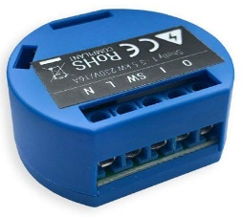
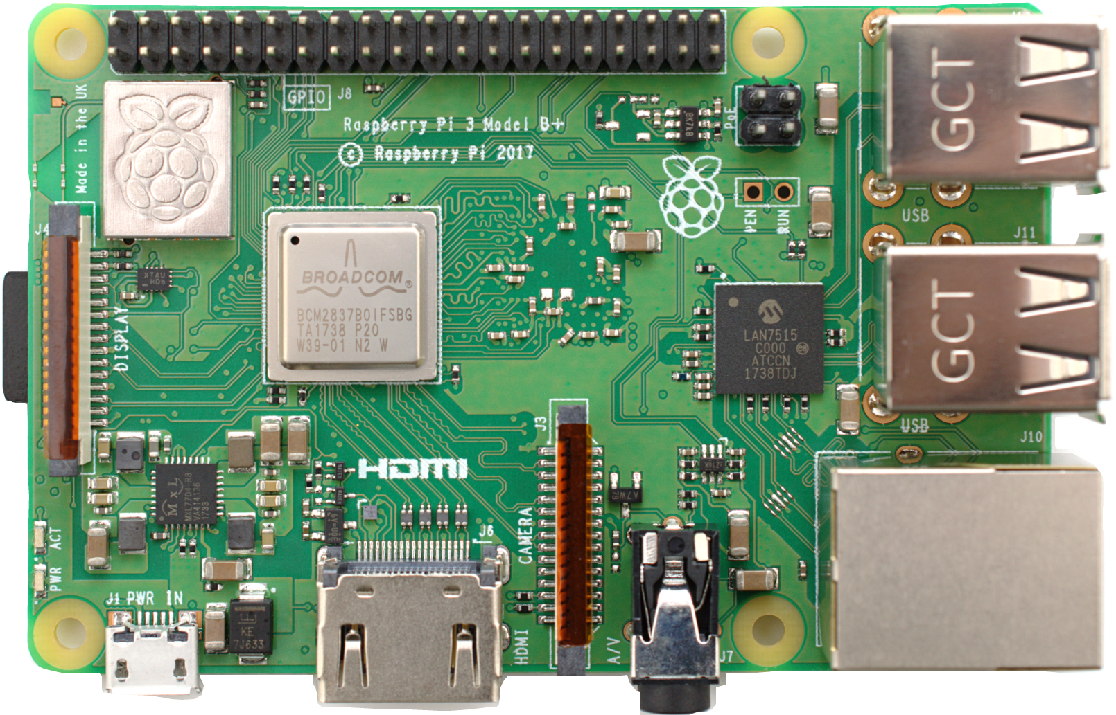



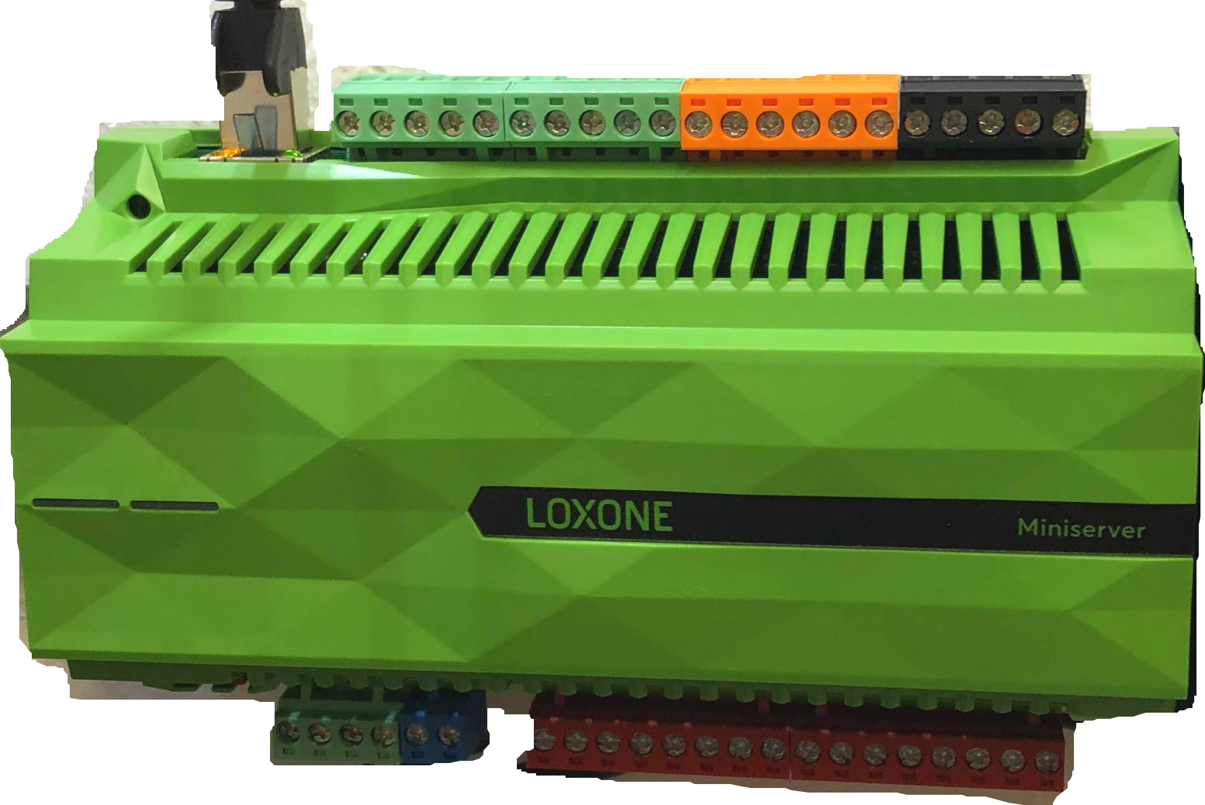





LoxBerry
MQTT protocol
← HTTP →
Your own MQTT script
← UDP →
MQTT protocol
MQTT Gateway
MQTT Broker Service
Installed by the MQTT Gateway plugin

